Slide 1

1
Presentation on
FACE MASK DETECTION
OF
BACHELOR OF TECHNOLOGY
IN
ELECTRONICS AND COMMUNICATION ENGINNERING
BY
PAWAN KUMAR (2018UGEC040R)
ROHAN GUPTA
(2018UGEC043R)
SHUBHANSHU KUMAR
(2018UGEC037R)
Submitted to
Prof Dr. Rashmi Panda
Dept. of Electronics and communication Engineering
INDIAN INSTITUTE OF INFORMATION TECHNOLOGY, RANCHI

Slide 2
2.
S.NO | CONTENT | Page No:
01 | Introduction | 3
02 | Development tools | 6
03 | System Requirement | 6
04 | Features | 7
05 | Snapshots | 8
06 | Source Code | 11
07 | Future and Scope | 14

Slide 3
3
INTRODUCTION
First of all to understand my project you have to understand computer
vision. Face tracking and detection features in sequence is an important and
fundamental problem in computer vision. This area of research has a lot of
applications in face identification systems, model based coding, gaze
detection, human computer, interaction, teleconferencing, etc.
human-computer interaction, teleconferencing, etc.
Open CV
OpenCV means Intel® Open Source Computer Vision Library. It is a
collection of C functions and a few C++ classes that implement some
popular Image Processing and Computer Vision algorithms. OpenCV has
cross-platform middle-to-high level API that consists of a few hundreds C
functions. It does not rely on external libraries, though it can use some when
it is possible. OpenCV is free for both non-commercial and commercial use.
OpenCV provides transparent interface to Intel Integrated Performance
Primitives (IPP). That is, it loads automatically IPP libraries optimized for
specific processor at runtime, if they are available.

Slide 4
4
Image Processing
Computer manipulation of images. Some of the many algorithms used in
image processing include convolution (on which many others are based),
FFT, DCT, thinning (or skeletonisation), edge detection and contrast
enhancement. These are usually implemented in software but may also use
special purpose hardware for speed. Image processing contrasts with
computer graphics, which is usually more concerned with the generation of
artificial images, and visualisation, which attempts to understand (real-
world) data by displaying it as an artificial image (e.g. a graph). Image
processing is used in image recognition and computer vision. Silicon
Graphics manufacture workstations which are often used for image
processing. There are a few programming languages designed for image
processing, e.g. CELIP, VPL, C++.

Slide 5
5
Face Tracking ​
Face detection and tracking are important in video content analysis since the ​
most important objects in most video are human beings. Research on face ​
tracking and animation techniques has been improved due to its wide range ​
of applications in security, entertainment industry, gaming, psychological ​
facial expression analysis and human computer interaction. Recent advances ​
in face video processing and compression have made face-to-face ​
communication be practical in real world applications. However, higher ​
bandwidth is still highly demanded due to the increasing intensive ​
communication. Model based low bit rate transmission with high quality ​
video offers a great potential to mitigate the problem raised by limited ​
communication resources. However, after a decade’s effort, robust and ​
realistic real time face tracking and generation still pose a big challenge. The ​
difficulty lies in a number of issues including the real time face feature ​
tracking under a variety of imaging conditions such as lighting variation, ​
pose change, self-occlusion and multiple non-rigid features deformation and ​
the real time realistic face modeling using a very limited number of feature ​
parameters. Traditionally, the head motion is modeled as a 3D rigid motion ​
with the local skin deformation, the linear motion tracking method cannot ​
represent the rapid head motion and dramatic expression change accurately.​

Slide 6
6
DEVELOPMENT TOOLS
1. we make our tool with Anaconda
2. language: python
3.we use sublime text as our editor
4. web-Browser:
google chrome /Microsoft Edge
System Requirements
On client side
. Operating system
. Web-Browser : google chrome /microsoft edge
On Server side
. Python

Slide 7
7
Features
1. An airtight matching algorithm
2.Scalability
3.Built-in privacy protection
4. Predictive Analytics
5. watchlist-as-a-sevice

Slide 8
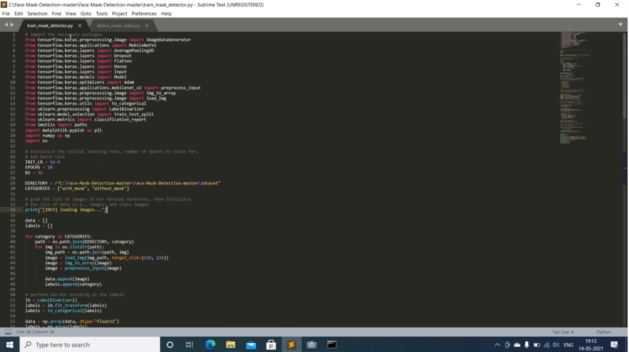
8
Snapshots
Codeusing sublime text

Slide 9
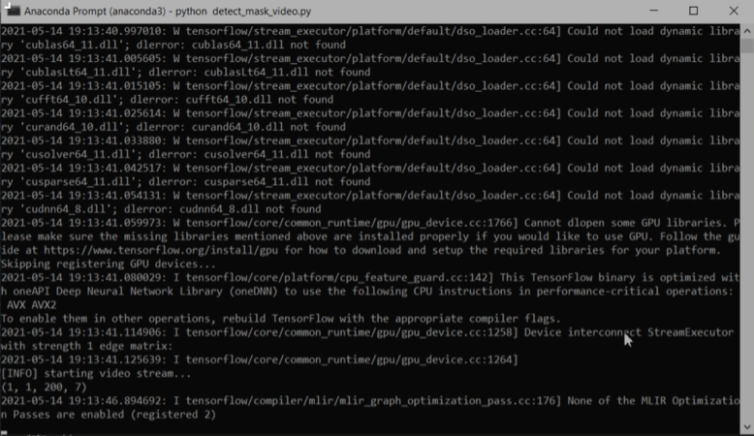
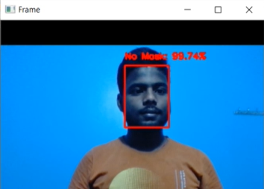
9
Debugging
Output as no mask

Slide 10
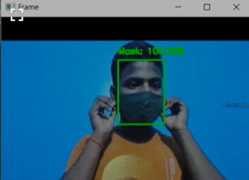
10
Output with mask

Slide 11
Source Code
11
from tensorflow.keras.applications.mobilenet_v2 import preprocess_input
from tensorflow.keras.preprocessing.image import img_to_array
from tensorflow.keras.models import load_model
from imutils.video import VideoStream
import numpy as np
import imutils
import time
import cv2
import os
def detect_and_predict_mask(frame, faceNet, maskNet):
(h, w) = frame.shape[:2]
blob = cv2.dnn.blobFromImage(frame, 1.0, (224, 224),
(104.0, 177.0, 123.0))
faceNet.setInput(blob)
detections = faceNet.forward()
print(detections.shape)
faces = []
locs = []
preds = []

Slide 12
for i in range(0, detections.shape[2]):
confidence = detections[0, 0, i, 2]
if confidence > 0.5:
box = detections[0, 0, i, 3:7] * np.array([w, h, w, h])
(startX, startY, endX, endY) = box.astype("int")
(startX, startY) = (max(0, startX), max(0, startY))
(endX, endY) = (min(w - 1, endX), min(h - 1, endY))
face = frame[startY:endY, startX:endX]
face = cv2.cvtColor(face, cv2.COLOR_BGR2RGB)
face = cv2.resize(face, (224, 224))
face = img_to_array(face)
face = preprocess_input(face)
faces.append(face)
locs.append((startX, startY, endX, endY))
if len(faces) > 0:
faces = np.array(faces, dtype="float32")
preds = maskNet.predict(faces, batch_size=32)
return (locs, preds)
prototxtPath = r"face_detector\deploy.prototxt"
weightsPath = r"face_detector\res10_300x300_ssd_iter_140000.caffemodel"
faceNet = cv2.dnn.readNet(prototxtPath, weightsPath)
12

Slide 13
13
maskNet = load_model("mask_detector.model")
print("[INFO] starting video stream...")
vs = VideoStream(src=0).start()
while True:
frame = vs.read()
frame = imutils.resize(frame, width=400)
(locs, preds) = detect_and_predict_mask(frame, faceNet, maskNet)
for (box, pred) in zip(locs, preds):
(startX, startY, endX, endY) = box
(mask, withoutMask) = pred
label = "Mask" if mask > withoutMask else "No Mask"
color = (0, 255, 0) if label == "Mask" else (0, 0, 255)
label = "{}: {:.2f}%".format(label, max(mask, withoutMask) * 100)
cv2.putText(frame, label, (startX, startY - 10),
cv2.FONT_HERSHEY_SIMPLEX, 0.45, color, 2)
cv2.rectangle(frame, (startX, startY), (endX, endY), color, 2)
cv2.imshow("Frame", frame)
key = cv2.waitKey(1) & 0xFF
if key == ord("q"):
break
cv2.destroyAllWindows()
vs.stop()

Slide 14
14
Future And Scope
Global Facial Recognition Scenario
Key player in the industry
Gadget Security
Distinguishing Genetic disorders

Slide 15
THANK YOU

